Slide 1
Presentation on General Analysis of Kulekhani-3 Hydropower Project
Presented By :
Suman Bahadur Chhetri

Slide 2
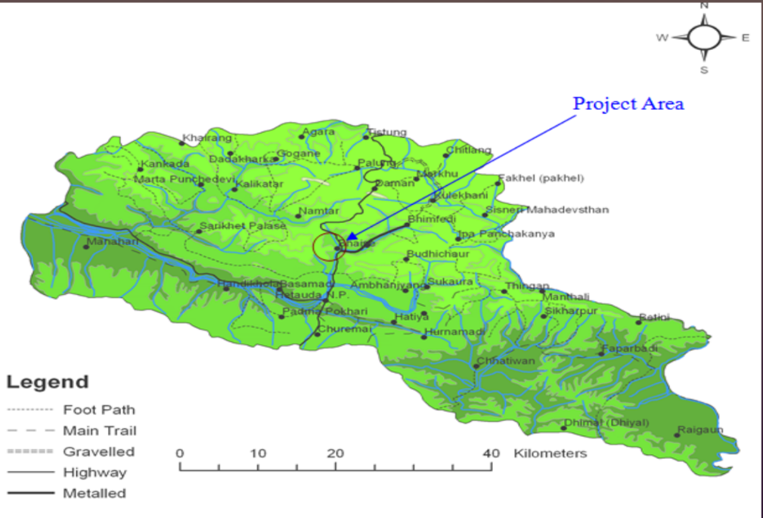
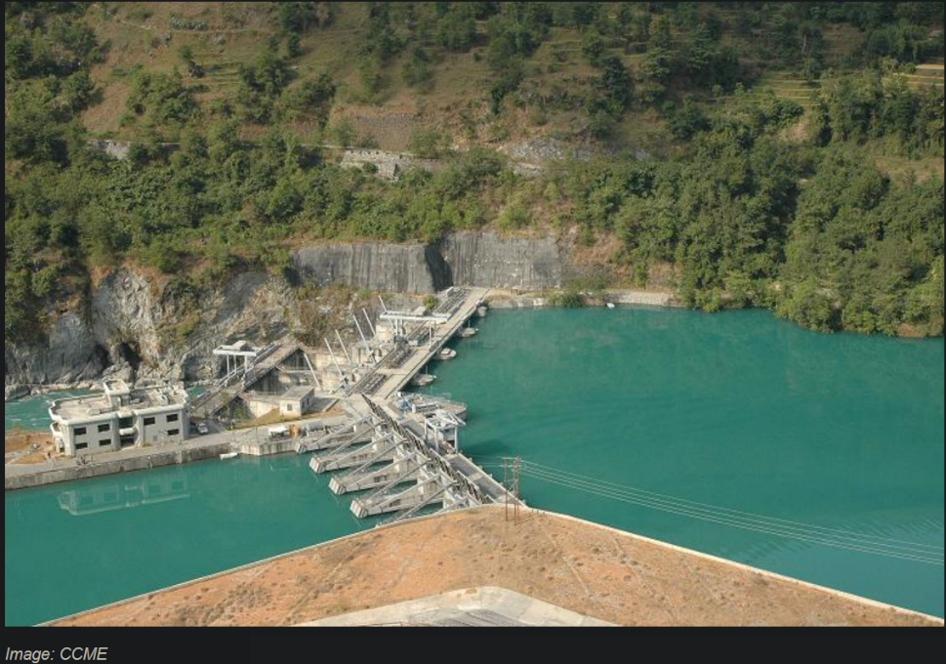
Overview of project
Kulekhani III hydroelectric project with an installed capacity of 14 MW (annual energy generation of 40.85 GWh) is a cascade scheme of Kulekhani storage project (Kulekhani I and Kulekhani II hydroelectric project, generating 60 and 32 MW peaking power, respectively).
It is designed to utilize the regulated flow of Kulekhani II hydroelectric project and natural flow of Khani Khola for the generation of electricity.

Slide 3
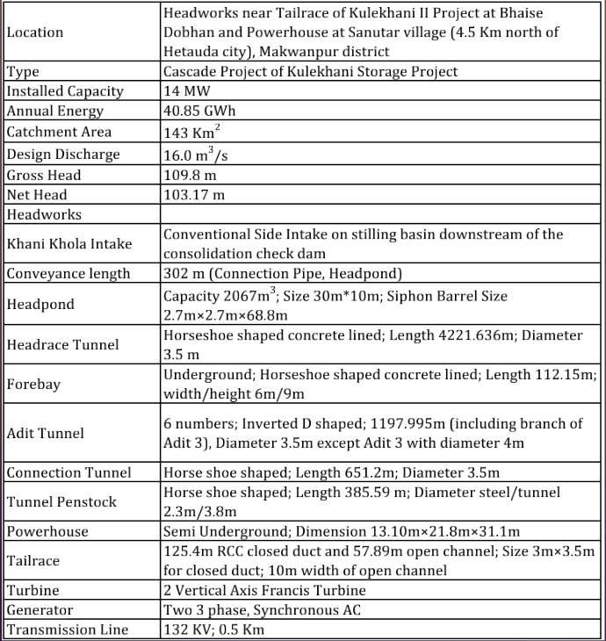

Slide 4
Forecast and actual of cost
The Kulekhani III Hydropower Project is being constructed with domestic investment.
initial estimated cost = Rs 2.43 billion
Actual cost = RS 5 BILLION
WHICH IS DOUBLE OF INTIAL COST.
IN 2014 , National planning commission declared kulekhani III as a troubled project.
Initial estimate cost = Rs173.6 million per megawatt
As per the revised estimate = expected to reach Rs310 million per megawatt.

Slide 5
Forecast and actual of time
construction began in April 2008.
originally scheduled to be finished by 2012.
Completion deadline has been scheduled for six times in January,2019.

Slide 6
Benefits delivered by projects
Since the project is still in the final process of completion, the final benefits can’t be outlined.
According to the Nepal Electricity Authority, the electricity generated by the project will be fed into the national grid by extending a half-kilometre-long transmission line from the powerhouse.
Road access has already been completed so local people can have full use of it.
This project is smaller one related to kulekhani I and kulekhani ii. The benefits are similar to those project for local people.
Chinese contractor, Jheijian Jialin has everything ready for project and is willing to finish as soon as possible as Nea(NEPAL ELECTRICIY AUTHORITY) STILL TRUST IN HIS WORK.

Slide 7
REASONS FOR DIFFERENCE IN PROJECT PERFORMANCE
Delay in Slow Permitting and Forced Re-design.
-the employer encountered problems acquiring the land for the access road AND TO CUT TREES.
Payment Issue
-The payment to the contractor was not made according to the bill submitted by the contractor.
Issues of Claim for Extension of Time (EoT)
-the EoT was not ultimately granted by the employer and those claims went unfulfilled (NEA Report, 2011).
OVER-LONG BUREAUCATIC PROCEDURES

Slide 8
Condition Forwarded by the Contractor
-The contractor tried to terminate the contract after sending notice of suspension to the employer. The specific conditions were forwarded by the contractor to the employer in order to resume the works as follows :
1) Extension of Time
2) Payment for all Completed Works
3) Prolongation Cost
4) Additional Cost
Late Selection of Electro-Mechanical Contractor
-Excavations of the powerhouse and tailrace were planned to start in July 2008 and to finish by the end of February 2009. The excavation of the powerhouse foundation was completed on March 5, 2009. However, the selection of an electro-mechanical contractor was finalized only in 2010 (NEA Report, 2014). As a result, the contractor could not obtain drawings and details for the powerhouse until October 2011.

Slide 9
KEY LESSON LEARNED
IN CONTEXT OF NEPAL, TIME ELONGATION FOR MAJOR PROJECTS HAS BECOME NORMS.
INITIAL ESTIMATES DOESNOT SHOWS THE PROJECTS COST RANGE BECAUSE IT CAN BE DOUBLED OR MORE.
CONTRACTORS ARE NOT ONLY TO BLAME FOR PROJECTS PACE.
LONG BUREUCRATIC PROCESS ALSO PLAYS VITAL ROLE ON PROJECT PERFORMANCE.
SATISFACTION OF LOCAL PEOPLE ALSO IS THE KEY FACTOR FOR PROJECT SMOOTH DEVELOPMENT.

Slide 10
REFERENCES
Dahal, khetraj and rai,nabina.2016. Contract Breach and Payment for Environmental Services: A Case from the Kulekhani III Hydroelectric Project in Nepal. Hydro Nepal.volume 19,p.38.
Karki,puja. Not found. Kulekhani-iii electric project.[online].[4/4/2020]. Available from: https://prezi.com/xbwekcx6ymsc/kulekhani-iii-hydroelectric-project/
Subedi,bibek.2019. Kulekhani-3 project misses deadline for sixth time. Money, the Kathmandu post. Available from :https://kathmandupost.com/money/2019/02/17/kulekhani-3-project-misses-deadline-for-sixth-time

